Slide 1
Portfolio Diversification with Rule Mining
Final Project – OMSBA 5270 | Harman Birring
OMSBA 5270 | Harman Birring

Slide 2
Executive Summary
Key Takeaways:
• Alphabet (GOOGL) = strongest financial health (HealthScore 0.78).
• Balanced $100k portfolio: Tech 27%, Retail 22%, Energy 21%, Finance 17%, Healthcare 13%.
• Risks diversified across 5 sectors with capped allocations (10–35%).
• COVID-19 stress test: Google fell initially but rebounded strongly within 30 days.
OMSBA 5270 | Harman Birring

Slide 3
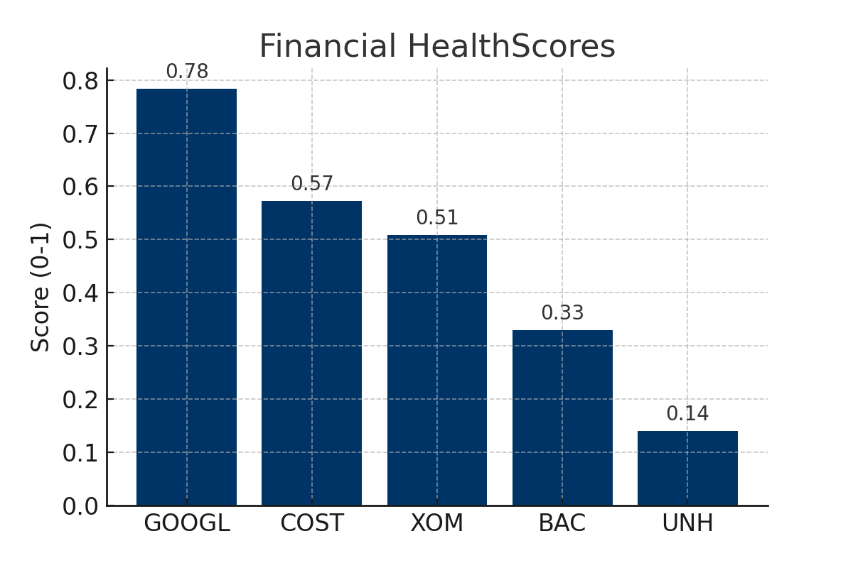
Financial HealthScores
OMSBA 5270 | Harman Birring

Slide 4
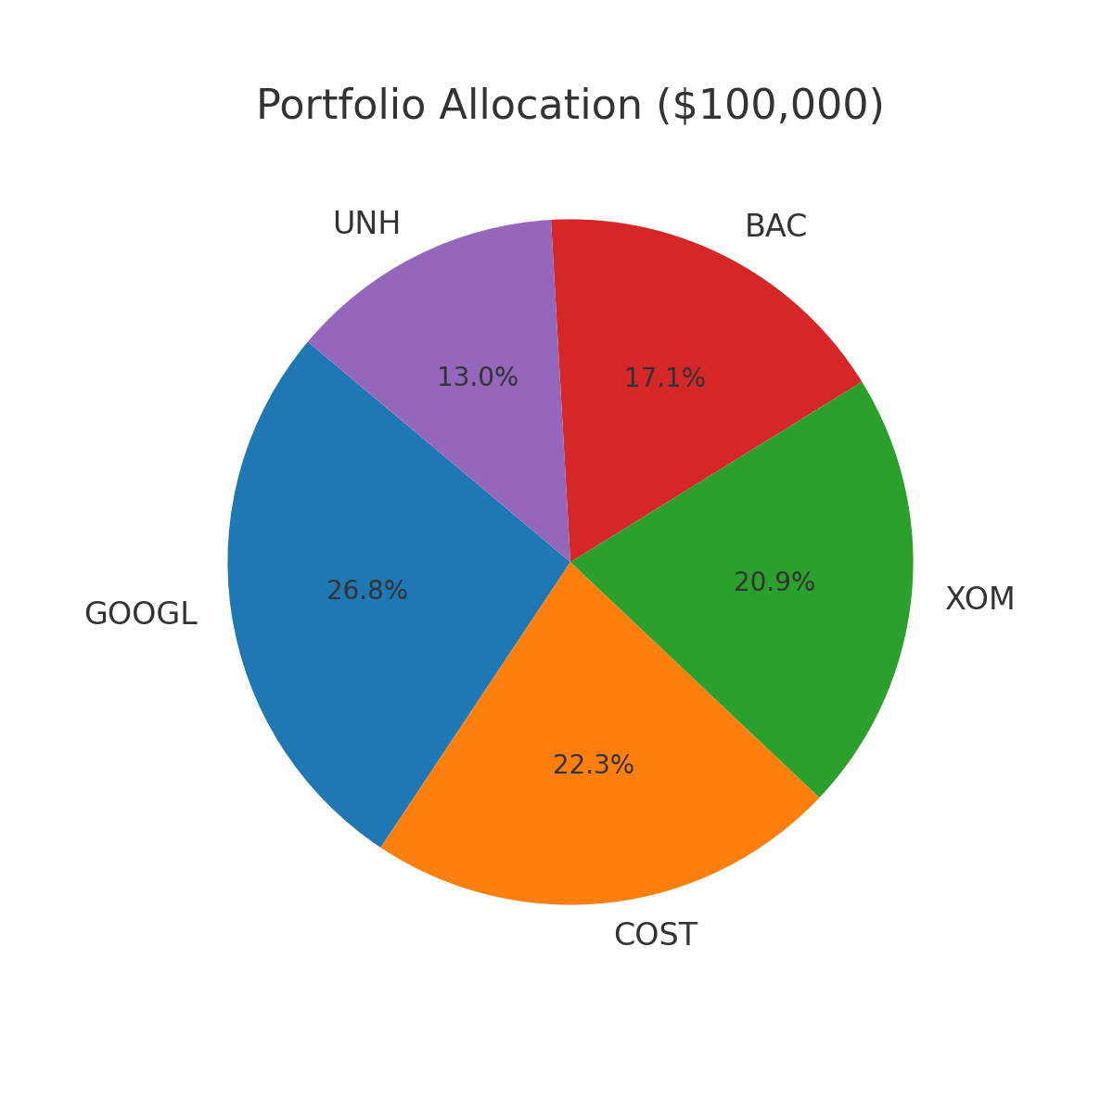
Portfolio Allocation
OMSBA 5270 | Harman Birring

Slide 5
Risk Assessment Matrix
Company | Likelihood | Impact
Exxon Mobil | High | High (Oil price volatility)
Bank of America | Medium | High (Regulation & compliance fines)
UnitedHealth | Medium | Medium (Healthcare regulations)
Google | High | High (Antitrust, AI competition)
Costco | Low | Medium (Thin margins, supply chain costs)
Exxon Mobil: Oil price fluctuations, energy transition risks.
Bank of America: Regulation, compliance costs, interest rate risk.
UnitedHealth: Regulatory pressures, Medicare billing risks.
Google: Antitrust lawsuits, AI competition.
Costco: Thin margins, supply chain & competition risks.
OMSBA 5270 | Harman Birring

Slide 6
Scenario Testing: COVID-19 Impact on Google
Event: WHO pandemic declaration, March 11, 2020.
5-day returns: -11.6% vs -4.5% (not significant).
20-day returns: -19.5% vs +13.2% (significant improvement).
30-day returns: -17.8% vs +17.8% (strong rebound).
OMSBA 5270 | Harman Birring

Slide 7
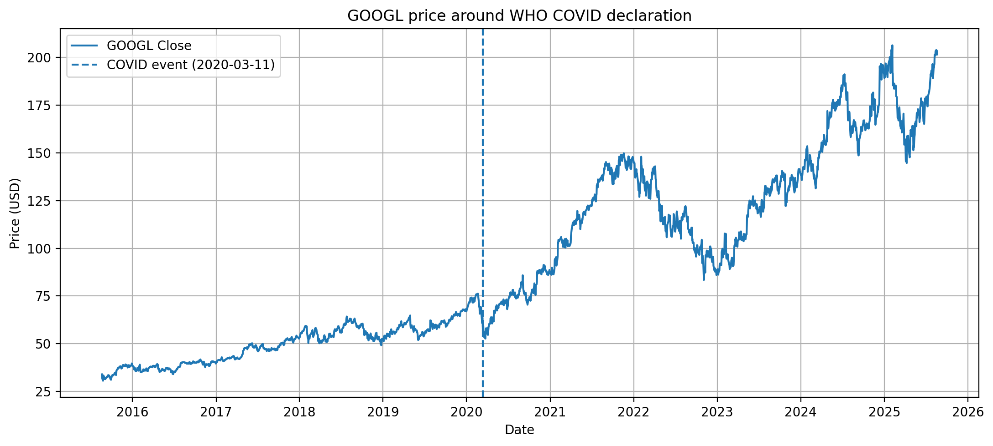
Scenario Testing: COVID-19 Impact on Google (Chart)
OMSBA 5270 | Harman Birring

Slide 8
Conclusion
• Diversified portfolio with balanced risk exposure across 5 sectors.
• Alphabet leads with strongest fundamentals; UNH weakest but included for diversification.
• Blended equal + score-based weighting ensured balance and control of risk.
• COVID-19 stress test confirmed resilience of top holdings like Google.
OMSBA 5270 | Harman Birring

Slide 9
Thank You
OMSBA 5270 | Harman Birring

